Slide 1
FNA Anomaly Detector Using Machine Learning for Breast Cancer Detection
Gia R. NATHAN
12th Grade, James Logan High School, Union City California 10/10/2023
Independent Research

Slide 2
Application
Problem Statement
Possible Solution
Solution Overview
Methodology Used
Machine Learning Model
Results
Summary

Slide 3
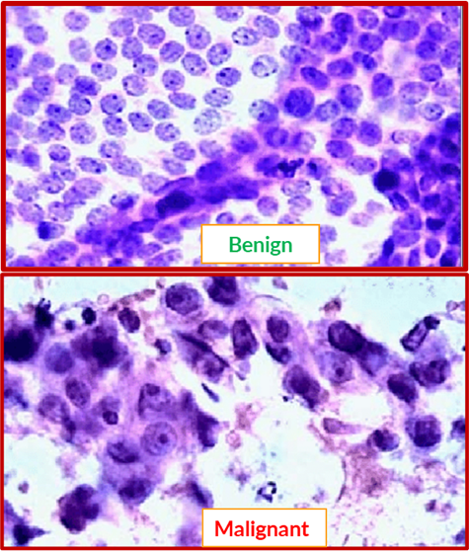
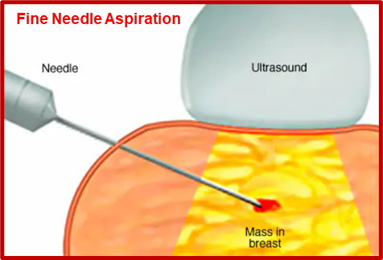
Project Purpose : FNA Anomaly Detector: A diagnostic Application for Cancer Detection
Breast Cancer is a leading cause of death among women world wide
Most patients do not have access to low cost diagnostic tools
I want to leverage the power of AI/ML in building an application which:
Acts like an early warning screening tool for cancer detection
Augments existing Fine Needle Aspiration Biopsy with detection function
The tool takes features derived Fine needle Aspiration images to generate actionable insights
FNA
Anomaly Detector
Point of Care Diagnostics

Slide 4
Problem Statement
Cancer Detection from FNA

Slide 5
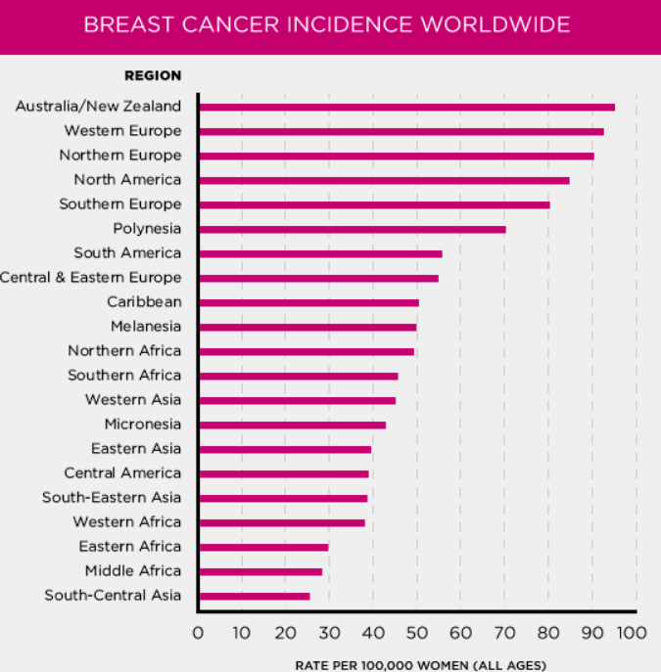
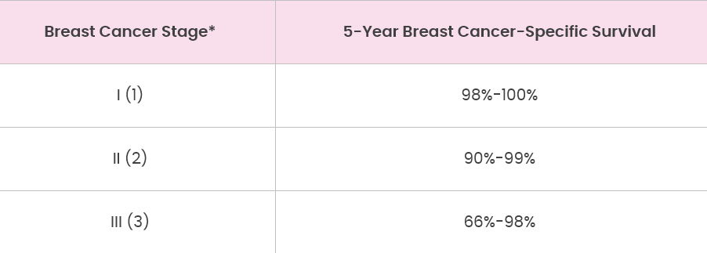
Problem Statement: Breast Cancer & Mortality Rates
Breast cancer is the leading cause of cancer mortality (death) among women in most countries in the world *
More than 680,000 breast cancer deaths occurred worldwide in 2020 (most recent data available).
Breast cancer is the most common cause of cancer mortality among women in developing countries
Early detection and intervention is the key to survival
Physicians express the need for
Simple, low cost diagnostic screening tools
Paired with smart communication devices
Universally available platform (Geographies etc.)
High Level of accuracy
Backward Compatibility and Complementary to existing tools
*n.b:Data & Diagrams Source: Susan G. Komen Foundation

Slide 6
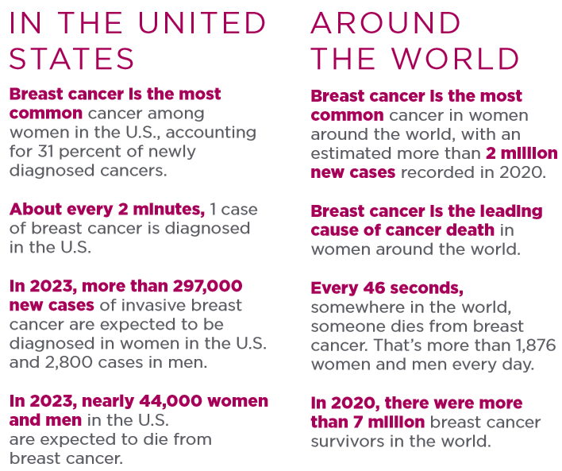
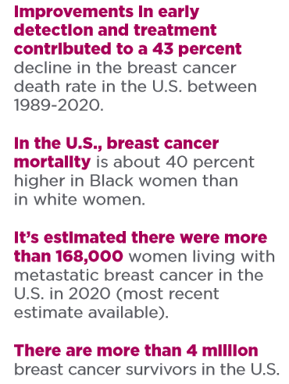
Problem Statement: Breast Cancer & Mortality Rates
*n.b:Data & Diagrams Source: Susan G. Komen Foundation

Slide 7
Solution Overview
Machine Learning Based Diagnostic Tool

Slide 8
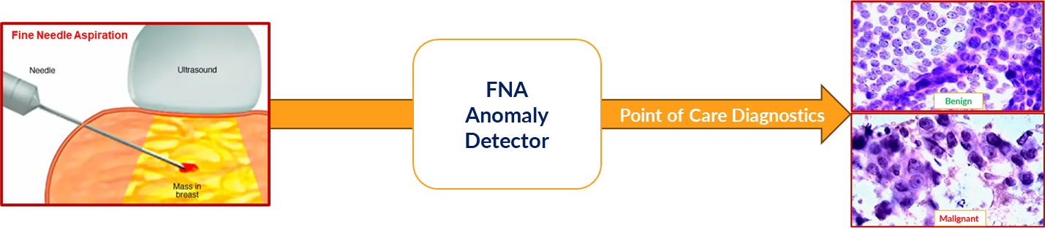
My Solution: FNA Anomaly Detector & What it Does
FNA AD Functions:
Aggregates a Patient’s FNA Biopsy data from a database
Develops an ML Model on the FNA image data
Generates Early Warning and Recommendations on mitigation plan
Generates progress report on the patient’s biopsy during and after the treatment
FNA Detector Features:
Suggest potential ways to prevent the customer default:
By flagging high interest debt by with a set of actions/recommendations
Real time monitoring with a workflow engine to trigger alerts and actions
Auto-scheduling payments based on pre-determined thresholds.
Simple intuitive Interface via Phone App
Back End Software as a Service Platform for Analysis

Slide 9
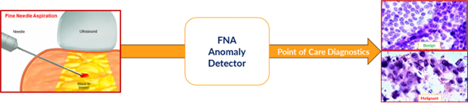
FNA Anomaly Detector : High Level Overview
The basic idea is to develop a classifier that takes in fine needle aspirate data and classifies it with a positive label (in case it’s an “anomaly”)
Assigns the numeric value of +1 (one), and a negative label (“for normal cells”) assigns the numeric value of -1 (minus one) for a benign cell sample.
In a real application the embedded classifier module is called by a diagnostic application on a medical device such as a laboratory analysis machine
Analytics module prints out details of the FNA test results when it gets a anomaly detected message from the classifier.

Slide 10
Machine Learning Based Solution: FNA Anomaly Detector for Cancer Detection

Slide 11
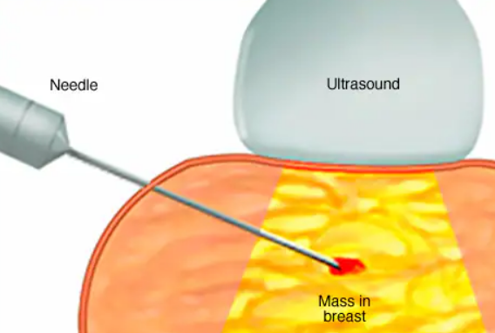
Fine Needle Aspiration
What is it ?
A biopsy is a medical diagnostic procedure to remove a piece of tissue or a sample of cells from a patient's body.
FNA or Fine Needle Aspiration is a type of biopsy
How it is done:
In FNA a small amount of breast tissue or fluid is removed from a suspicious area and checked for cancer cells.
A very thin needle and syringe to remove a sample of cells, tissue or fluid from an abnormal area or lump in the body.
The sample is then examined under a microscope.

Slide 12
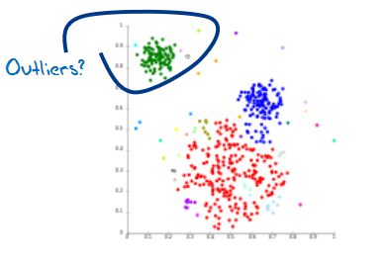
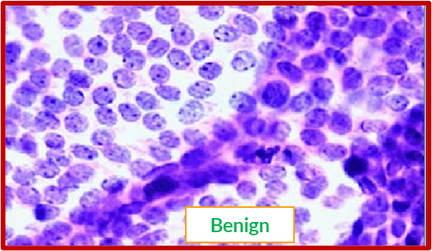
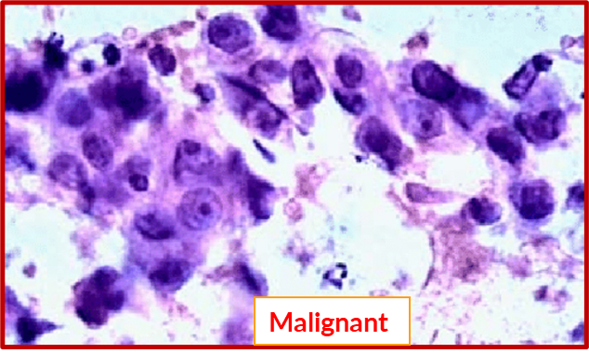
Machine Learning (ML) for FNA Anomaly Detection
What it does :
Detects malignancy based on anomalies in FNA Biopsy samples
How it is done:
Initial goal is to use a supervised machine learning model
That does Real time Classification of FNA biopsy sample
Separates cell tissue into two classes
Normal/Benign
Malignant
Labeled training samples used to learn a classification hyperplane
Machine Model developed from Fine Needle Aspiration Biopsy data
How it is deployed:
A standalone classification software package that works with FNA module in Biopsy Analytics software
This software can be pushed to interact with FNA control plane via a docker container
Can be Sold as an upsell application on top of Existing FNA Analytics Software

Slide 13
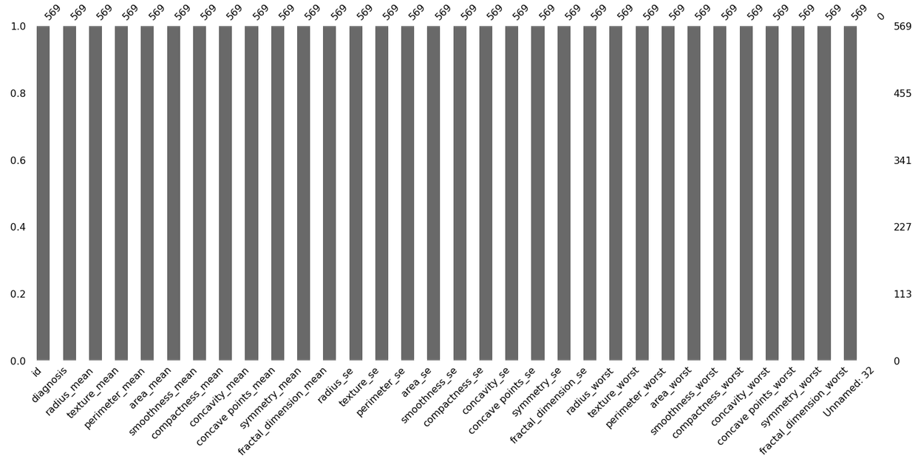
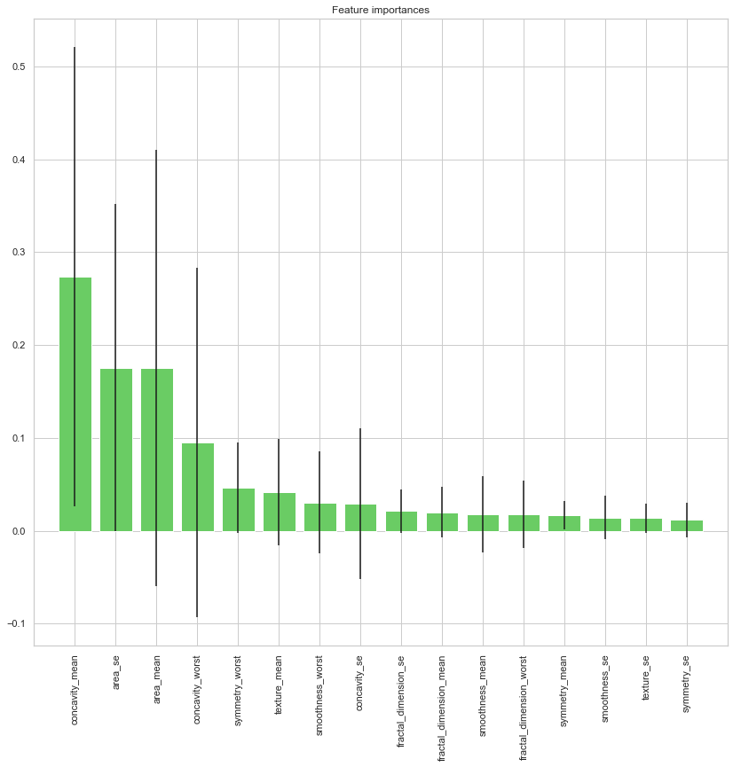
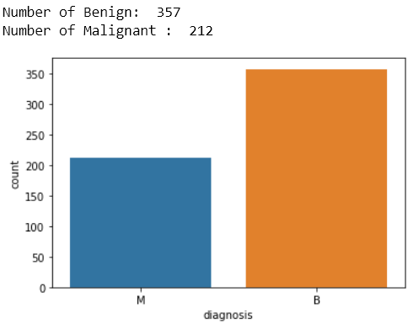
Methodology Used
UW-Madison breast cancer dataset
Contains 569 distinct records with 33 columns
Represents features that are computed from a digitized image
Image contains Fine needle aspirate (FNA) of a breast mass.
Describes characteristics of the cell nuclei
FNA data is used for developing a classification model
Model detects malignant breast cancer cells in a patient's FNA biopsy sample.

Slide 14
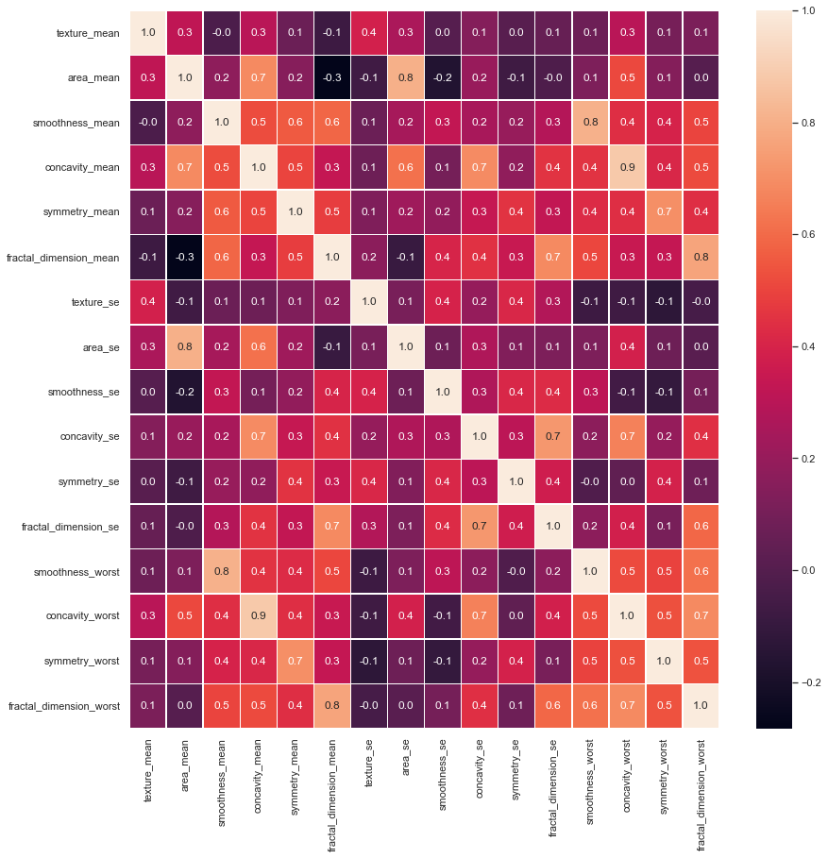
Methodology Used
Visualization and Basic statistical analysis was done to remove correlated features
Feature ranking was done with Recursive Feature Elimination. (RFE)

Slide 15
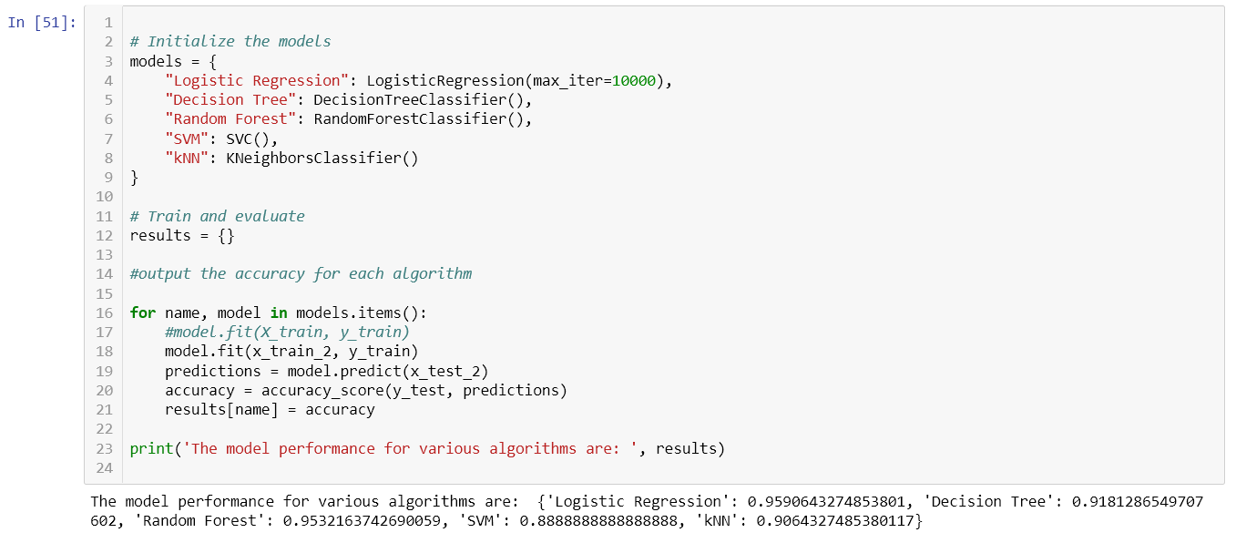
Methodology Used
Multiple models were built using Supervised Learning
Logistic Regression
RandomForest
KNN
Support Vector Machine
Logistic Regression was selected as it had the best performance

Slide 16
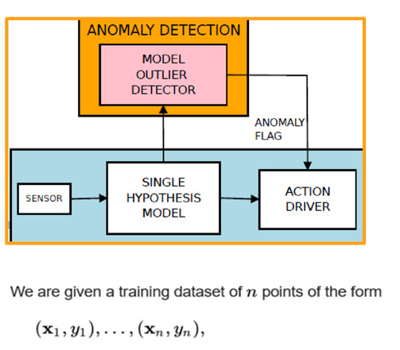
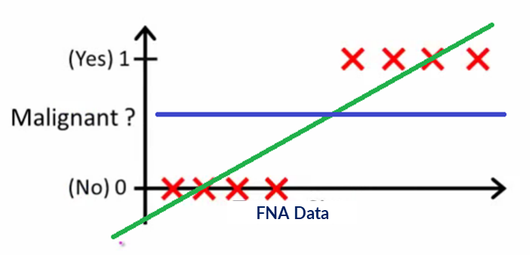
Logistic Regression Explained
Anomaly Detector High Level Functional Blocks
The idea is to come up with a two class classifier that classifies FNA data with
1 indicating an anomaly and 0 indicating normal cell

Slide 17
Logistic Regression Explained
Logistic regression is a statistical method for predicting binary classes.
The outcome or target variable is dichotomous in nature.
Dichotomous meaning there are only two possible classes.
Special case of linear regression where the target variable is categorical in nature
Uses a log of odds as the dependent variable.
Computes the probability of occurrence of a binary event utilizing a logit function. (malignant/benign)

Slide 18
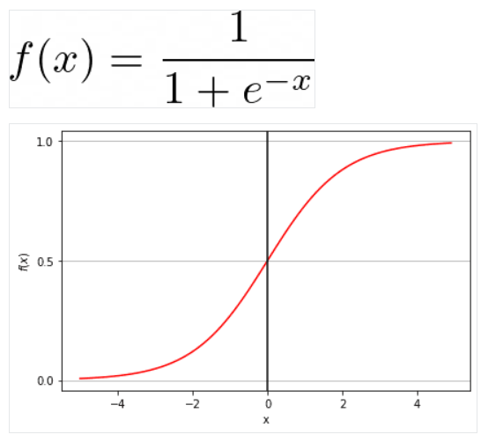
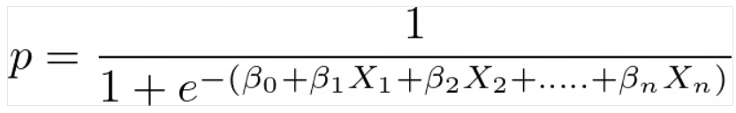
Logistic Regression Explained
Linear Regression Equation:
y is a dependent variable and x1, x2 ... and Xn are explanatory variables
Sigmoid Function:
Outputs an ‘S’ shaped curve
Can take any real-valued number
Maps it into a value between 0 and 1.
If the curve goes to positive infinity, y predicted will become 1
If the curve goes to negative infinity, y predicted will become 0.
If the output of the sigmoid function is more than 0.5, we can classify the outcome as 1 or YES
If it is less than 0.5, we can classify it as 0 or NO.
Apply Sigmoid function on linear regression:

Slide 19
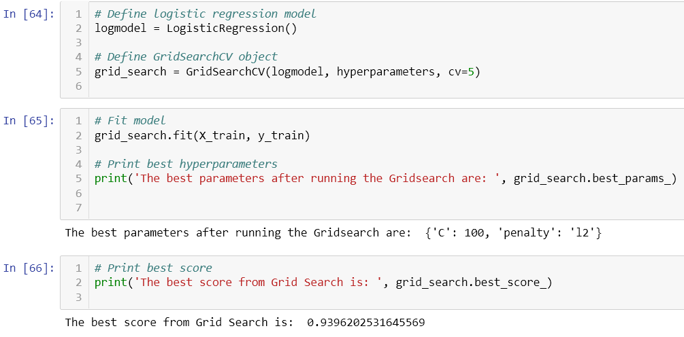
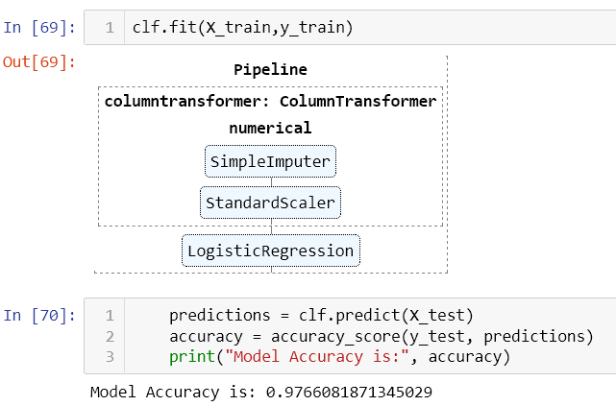
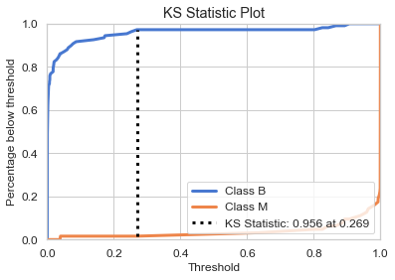
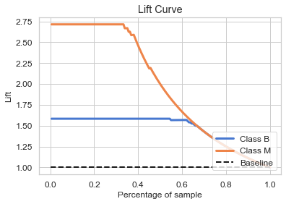
Methodology Used
GridSearch was used to do the best hyperparameter selection
The parameters were used to build the final model
This new model was used for classification of new FNA data as:
Benign
Malignant

Slide 20
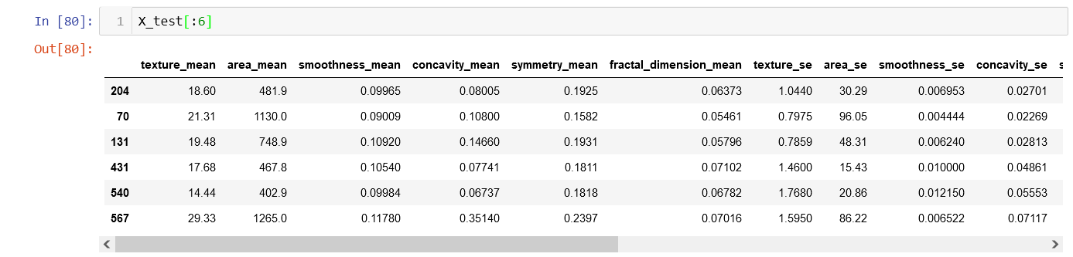
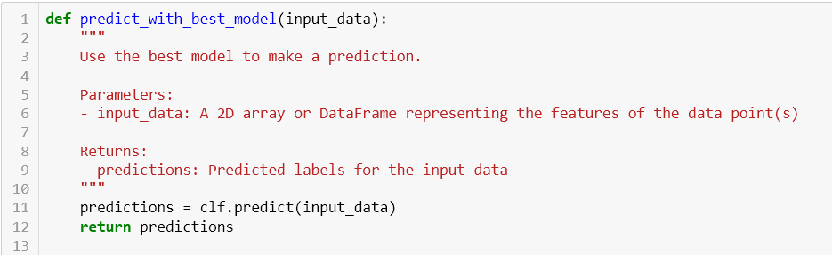
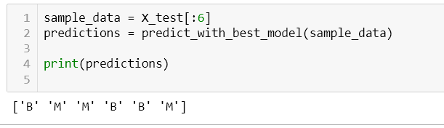
Result Summary
The resulting model is able to classify new FNA test data like so:
“B” for Begnign Cell
“M” for anomalous cell
Example below:

Slide 21
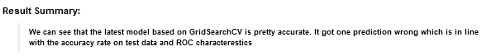
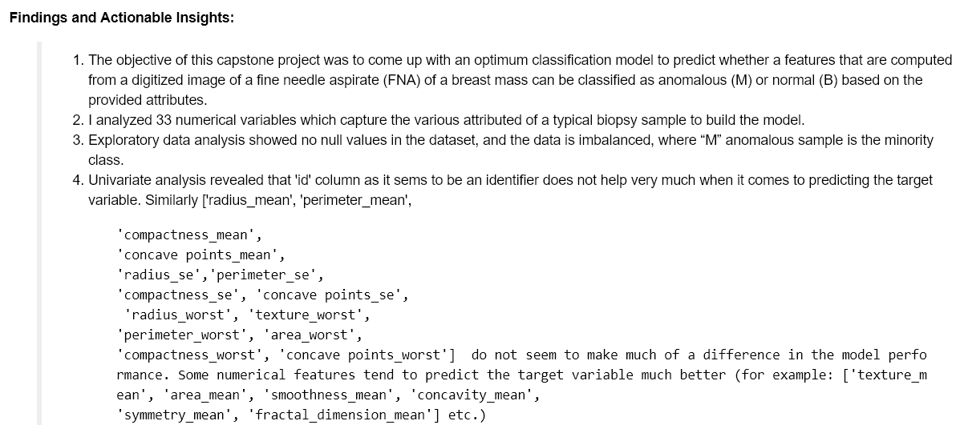
Results Summary: Actionable Insights

Slide 22
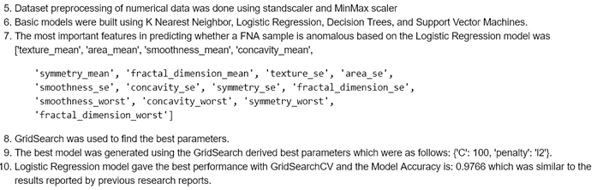
Results Summary: Actionable Insights

Slide 23
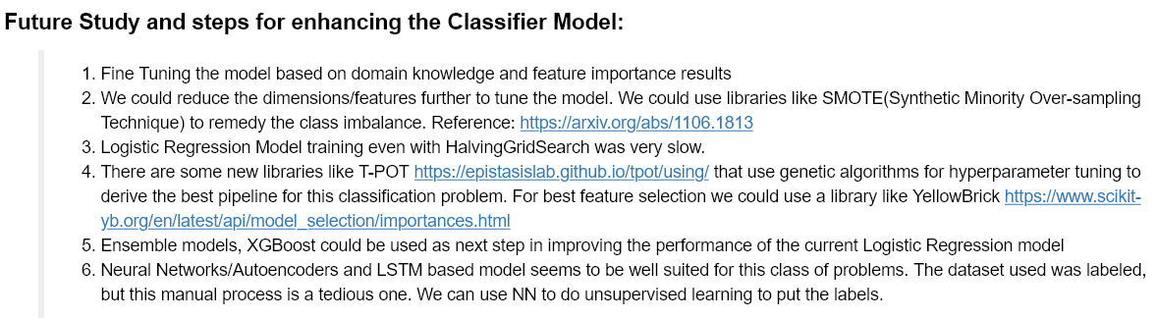
Next Steps

Slide 24
THANK YOU !
© Gia R. Nathan
gn1188@nhusd.k12.ca.us

